Slide 1
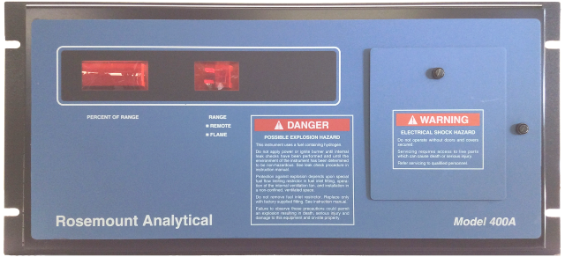
400A Training

Slide 2
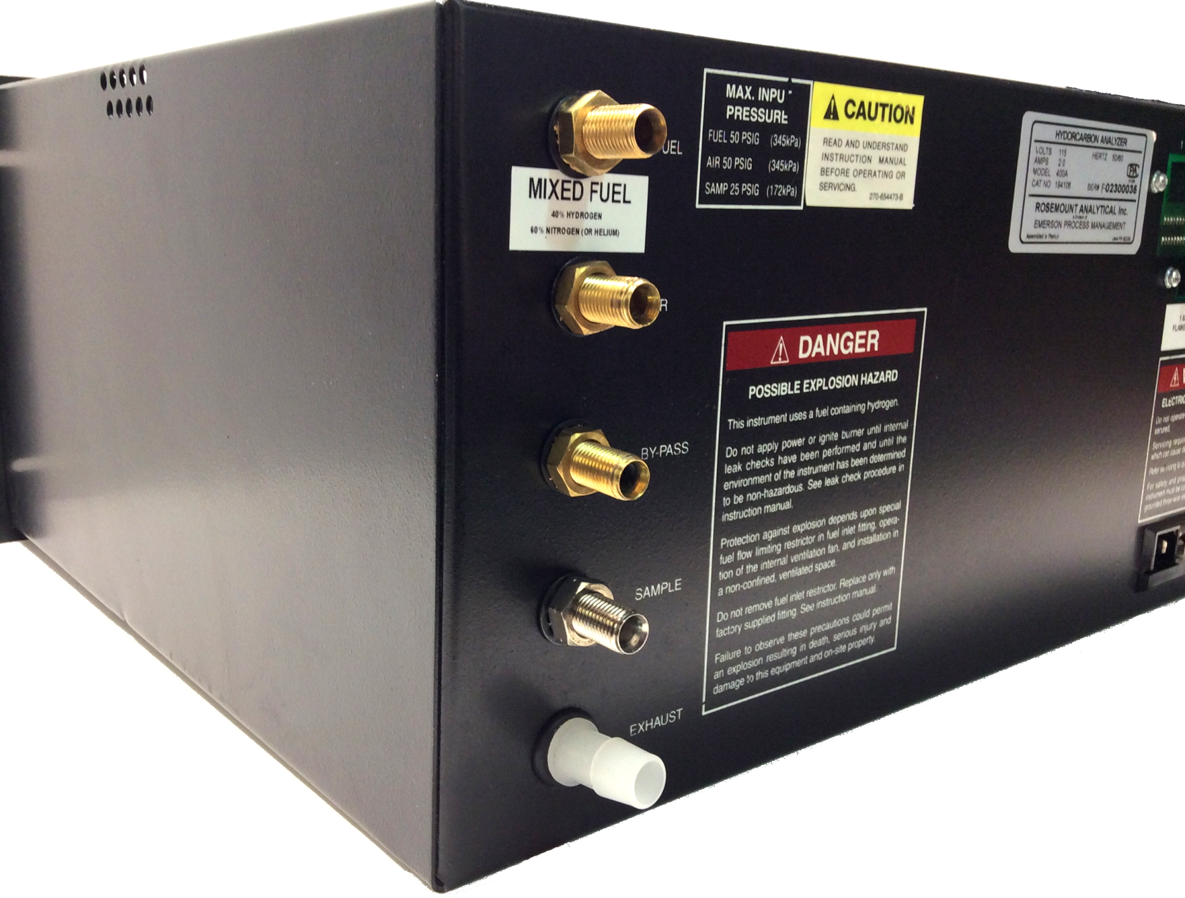

Slide 3
Overview
Great ‘old’ technology analyzer
(Flame Ionization Detector (FID) was invented by Ian McWilliam in 1957)
Simple design
(just enough pneumatics to make it work)
(electronics not excessively complicated; 96.15% [arbitrary number] analog based)
“Work horse”
(some users run the analyzer 24/7/365 for years before it requires repair)
“Technician proof”
(there are minimal adjustment pots; just light it, calibrate, and go)
“Fairly simple to service”
(there is plenty of room to get hands and tools in to do the servicing)

Slide 4
Theory
Highlighted text discussed next page
The Model 400A Hydrocarbon Analyzer utilizes the flame ionization method of detection. The sensor is a burner in which a regulated flow of sample gas passes through a flame sustained by regulated flows of air and a fuel gas (hydrogen or a hydrogen/diluent mixture). Within the flame, the hydrocarbon components of the sample stream undergo a complex ionization that produces electrons and positive ions. Polarized electrodes collect these ions, causing current to flow through electronic measuring circuitry. Current flow is proportional to the rate at which carbon atoms enter the burner.

Slide 5
Theory
FID … Flame Ionization Detection
Burning a hydrocarbon compound liberates electrons and positive ions
The number of ions (analyzer response) can be roughly estimated by the carbon number
Methane (CH₄) has an effective carbon number of 1
Hexane (C₆H₁₄) has an effective carbon number of 6
Methanol (CH₃OH) has an effective carbon number of 0.76 (the OH radical affects the liberation of the ions)
Therefore, burning 600 ppm of Methane looks EXACTLY like burning 100 ppm of Hexane. In this example, Hexane is said to have a 600 ppm equivalent Methane response.

Slide 6
Theory
Highlighted text discussed next page
The Model 400A Hydrocarbon Analyzer utilizes the flame ionization method of detection. The sensor is a burner in which a regulated flow of sample gas passes through a flame sustained by regulated flows of air and a fuel gas (hydrogen or a hydrogen / diluent mixture). Within the flame, the hydrocarbon components of the sample stream undergo a complex ionization that produces electrons and positive ions. Polarized electrodes collect these ions, causing current to flow through electronic measuring circuitry. Current flow is proportional to the rate at which carbon atoms enter the burner.

Slide 7
Theory
“Regulated flow of sample gas passes through a flame sustained by regulated flows of air and a fuel gas.”
Air … 15 psig … 500 cc/min
Fuel … 25 psig … 75 cc/min (pure fuel: 35 cc/min)
Sample … 5 psig (all THC response specifications are based on 5 psig sample pressure)

Slide 8
Theory
“Regulated flow of sample gas passes through a flame sustained by regulated flows of air and a fuel gas.”
Fuel and air flows are not very critical as long as they are near the specified value & their pressure is stable
Sample pressure (i.e., capillary flow) is critical
Calibration integrity
Calibrating @ 5psig and operating @4.5psig results in lower (i.e., inaccurate) process values
Burner jet (tip) cooling (in pure fuel analyzers)

Slide 9
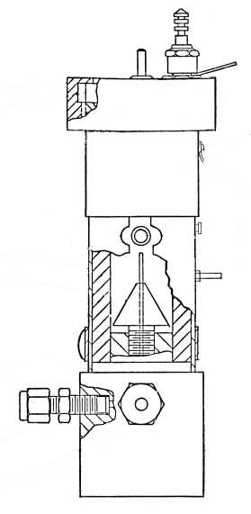
Theory
“Regulated flow of sample gas passes through a flame sustained by regulated flows of air and a fuel gas.”
Bulkhead fitting
& embedded restrictor
Gauge
Bypass/vent
BPR
Sample Capillary

Slide 10
Theory
“Regulated flow of sample gas passes through a flame sustained by regulated flows of air and a fuel gas.”
5 psig
5 psig
Bulkhead fitting
& embedded restrictor
Gauge
Approx. 2500 cc/min
8 psig
Bypass/vent
BPR
Sample Capillary
This would be considered a “normal” even “optimal” sample set up. The analyzer is getting maximum designed sample flow through its capillary, and the delta between supply pressure and regulated pressure means that there is sufficient bypass for a fast response to the process.
13.5 cc/min

Slide 11
Theory
“Regulated flow of sample gas passes through a flame sustained by regulated flows of air and a fuel gas.”
5 psig
Bulkhead fitting
& embedded restrictor
Gauge
5 psig
0 cc/min
5 psig
Bypass/vent
BPR
This would be considered an “abnormal” sample set up. The analyzer is getting maximum designed sample flow through its capillary, but the delta between supply pressure and regulated pressure is 0 (zero) PSID which means that there is NO bypass flow. Response to process changes could take minutes, hours, or days.
Sample Capillary
13.5 cc/min

Slide 12
Theory
“Regulated flow of sample gas passes through a flame sustained by regulated flows of air and a fuel gas.”
4.5 psig
Bulkhead fitting
& embedded restrictor
Gauge
5 psig
0 cc/min
4.5 psig
Bypass/vent
BPR
This would be considered an “improper” sample set up. The analyzer is NOT getting maximum designed sample flow through its capillary, and the delta between supply pressure and regulated pressure is -0.5 (negative) PSID which means that there is NO bypass flow. Response to process changes could take minutes, hours, or days. Also, the calibration is based on 5 psig of sample so now the calibration is VOID.
Sample Capillary
≈11 cc/min

Slide 13
Theory
Larry to improve this slide before releasing.
“Regulated flow of sample gas passes through a flame sustained by regulated flows of air and a fuel gas.”
>5.0 psig
Bulkhead fitting
& embedded restrictor
Gauge
5 psig
4000+ cc/min
10.0 psig
Bypass/vent
BPR
This would be considered an “improper” sample set up. The analyzer is getting MORE THAN the maximum designed sample flow through its capillary, and the delta between supply pressure and regulated pressure is GREATER THAN ITS CAPACITY to control, which means that there is TOO MUCH capillary flow. Response to process changes will be VERY quick but highly inaccurate.
Sample Capillary
>13.5cc/min

Slide 14
Theory
“Regulated flow of sample gas passes through a flame sustained by regulated flows of air and a fuel gas.”
Bulkhead fitting
& embedded restrictor
Gauge
Bypass/vent
BPR
Sample Capillary
An inlet flowmeter with metering valve is not a good idea.
Let the analyzer control its own flow by giving it a stable source pressure (see later slides).

Slide 15
Theory
“Regulated flow of sample gas passes through a flame sustained by regulated flows of air and a fuel gas.”
Bypass/vent
Bulkhead fitting
& embedded restrictor
Gauge
BPR
Sample Capillary
Putting a flowmeter (without a metering valve) on the bypass line is a perfectly acceptable practice.

Slide 16
Theory
“Regulated flow of sample gas passes through a flame sustained by regulated flows of air and a fuel gas.”
Bypass/vent
Bulkhead fitting
& embedded restrictor
Gauge
BPR
Sample Capillary
Adding a forward pressure regulator here will maintain a perfect pressure & flow balance within the analyzer. This allows the process pressure to deviate wildly without affecting the analysis (or bypass rate).

Slide 17
Theory
Highlighted text discussed next page
The Model 400A Hydrocarbon Analyzer utilizes the flame ionization method of detection. The sensor is a burner in which a regulated flow of sample gas passes through a flame sustained by regulated flows of air and a fuel gas (hydrogen or a hydrogen/diluent mixture). Within the flame, the hydrocarbon components of the sample stream undergo a complex ionization that produces electrons and positive ions. Polarized electrodes collect these ions, causing current to flow through electronic measuring circuitry. Current flow is proportional to the rate at which carbon atoms enter the burner.

Slide 18
Theory
“Polarized electrodes collect these ions, causing current to flow through electronic measuring circuitry.”
90 vDC power supply drives the positive ions & electrons to the electrodes
The “hot dog” (burner contact assembly)
And the collector ring
Electrometer circuit measures the minute ion current
Preamp board

Slide 19
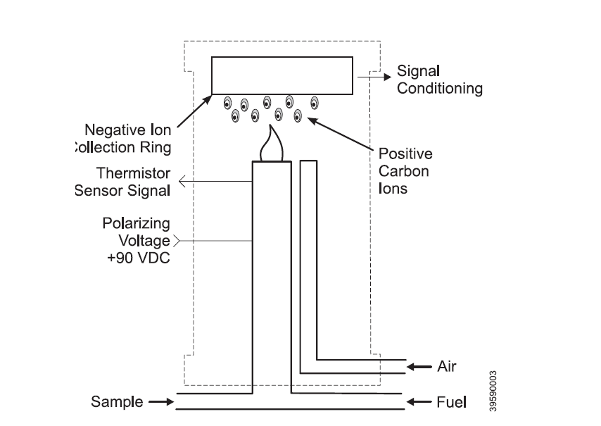
Theory
Thermistor
Glow plug
Preamplifier Board (electrometer)
Air escapes through a hole in the manifold assembly
+90 VDC is isolated from ground by the Teflon (mushroom) in the burner jet assembly. The jet itself is a 1/16” SS tube.
Actual burner
Graphic is an original from the Rosemount 400A manual; corrections in red.

Slide 20
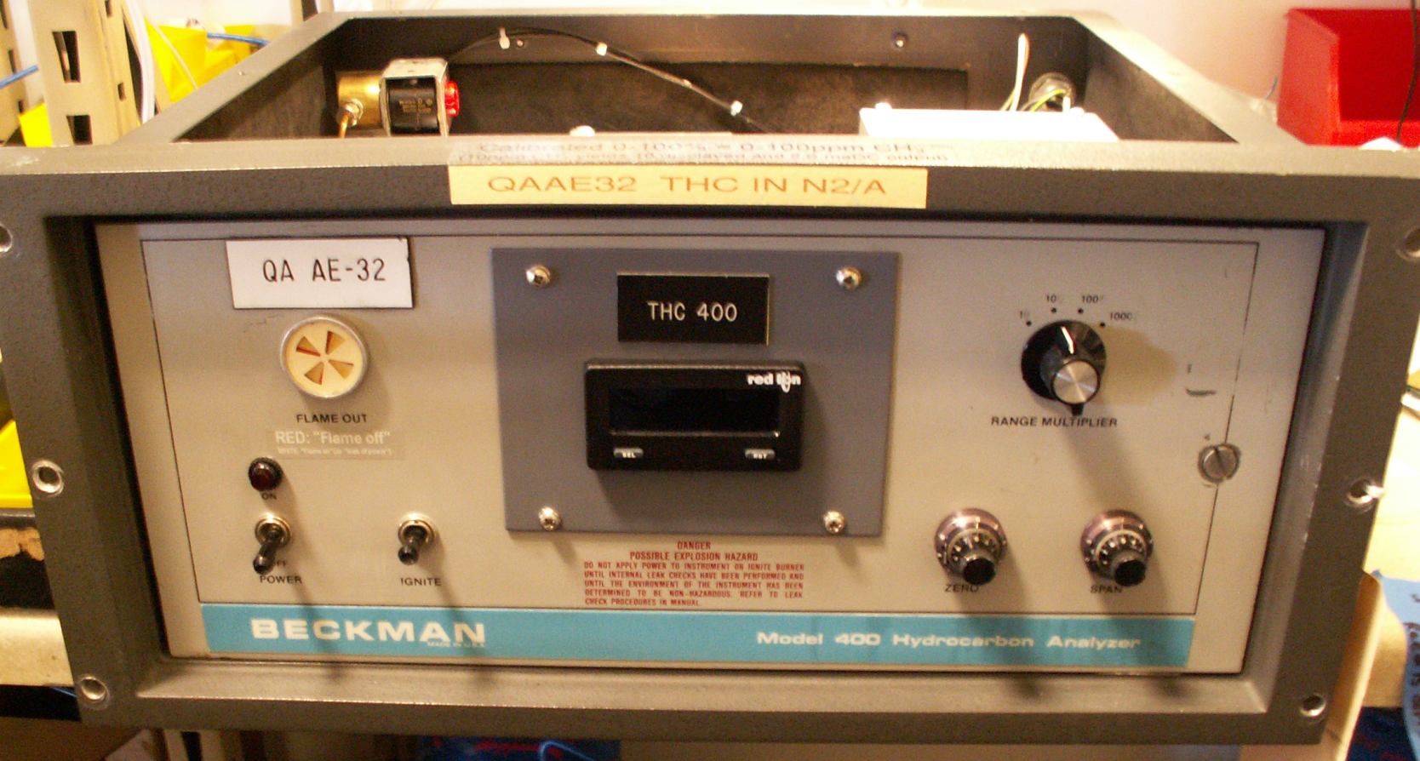
Versions
In the beginning …
… there was the Beckman 400.

Slide 21
Versions
In the beginning …
… there was the Beckman 400.
The digital display was a modification towards the end of the product run, and sometimes installed by the end user or a field service engineer.

Slide 22
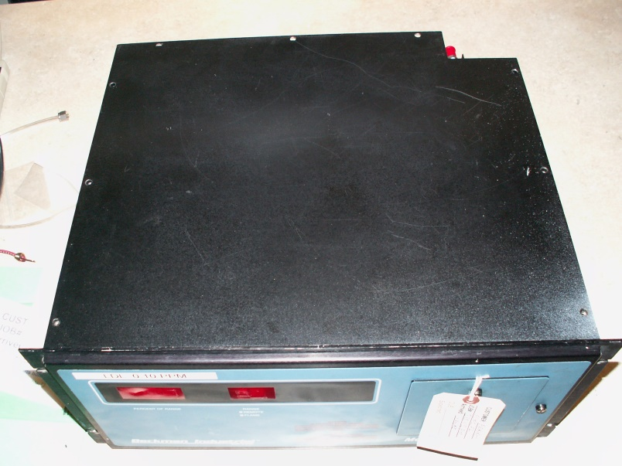
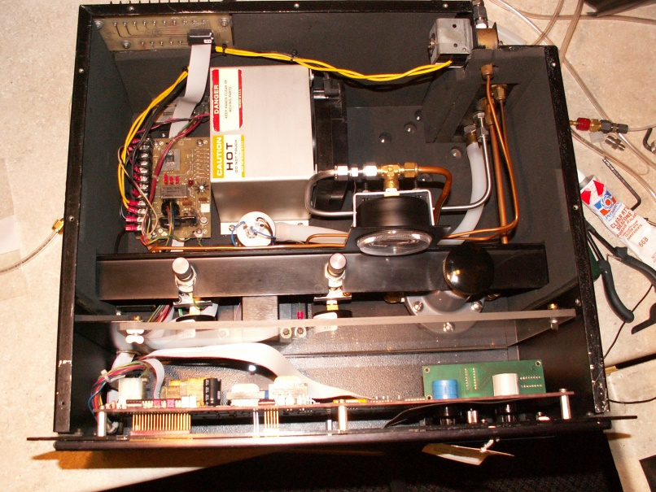
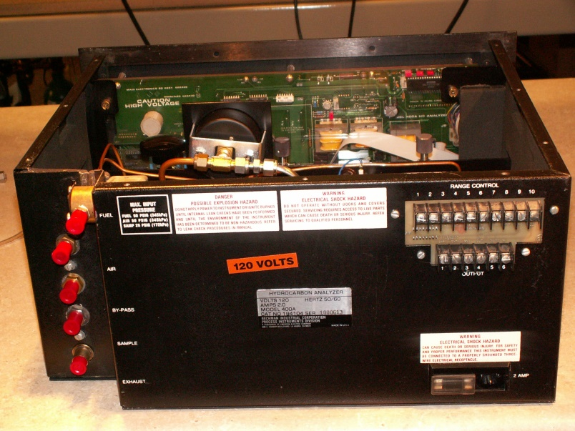
Versions (pre 2000)
400A from before 2000 (note the notch in the right rear corner of the case)

Slide 23
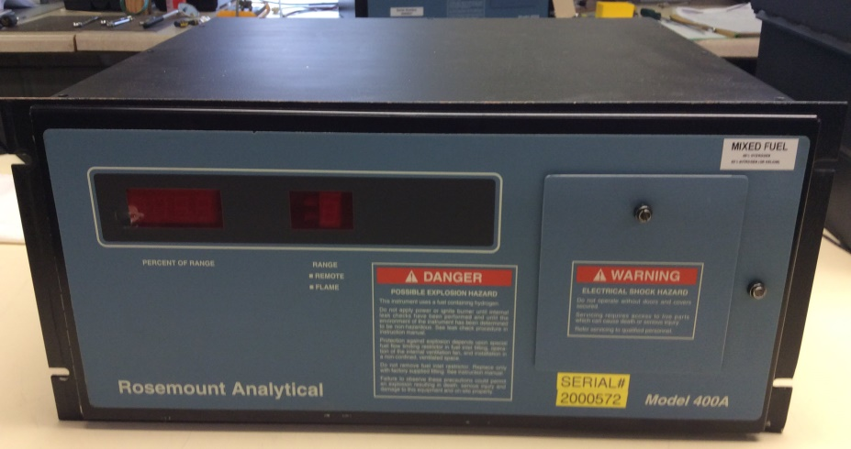
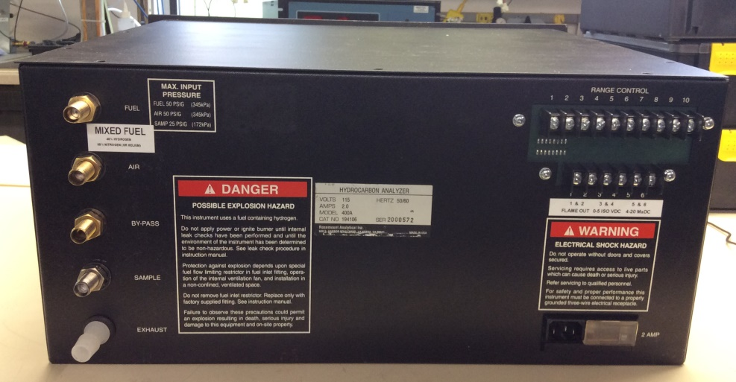
Versions (2000 to 2009)
400As after about 2000 did not have the notch in the right rear corner of the case

Slide 24
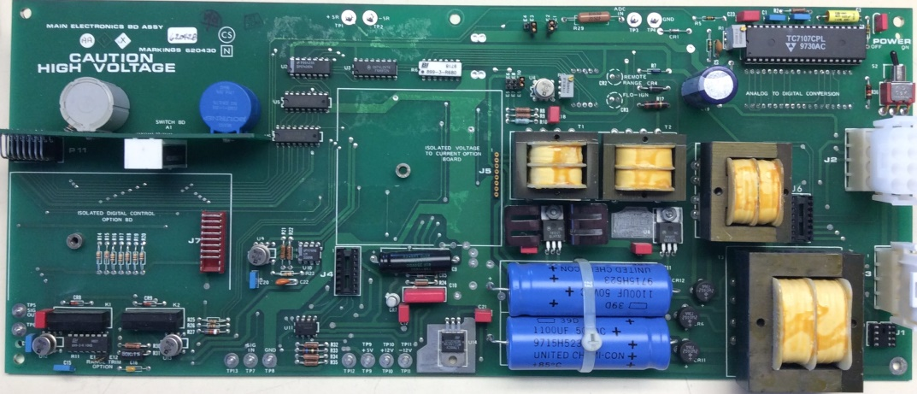
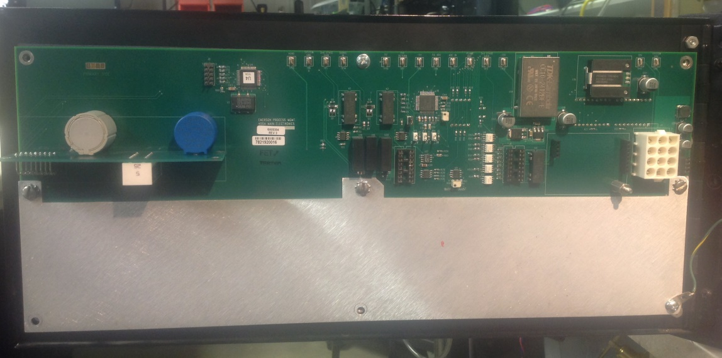
Versions (after 2009)
Old version
(pre 2009)
New version
(post 2009)
400As after 2009 have a miniaturized version of the Main Electronics Board

Slide 25
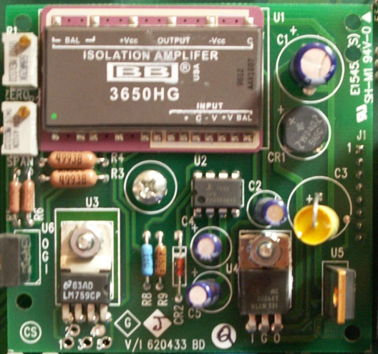
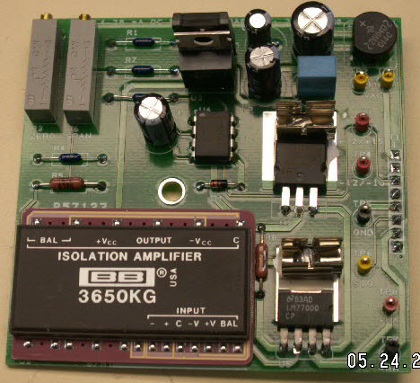
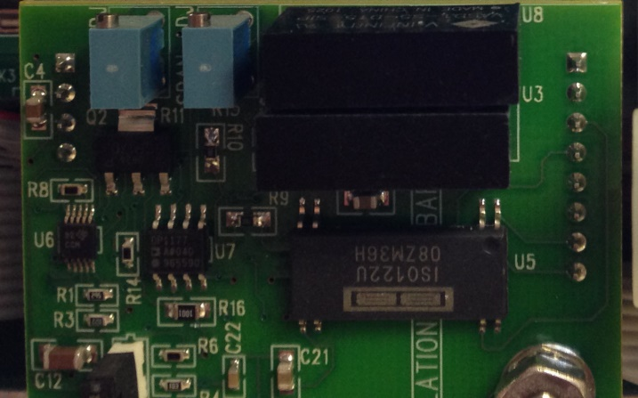
Versions (after 2009)
Old version(s)
(pre 2009)
New version
(post 2009)
400As after 2009 have a miniaturized version of the daughter boards too

Slide 26
Gases & their connections
Fuel
40/60 H₂/He (or 40/60 H₂/N₂) or 100% H₂
All FID grade fuels (< 0.5 ppm THC & <5ppm H₂O)
Air (burner air) … Ultra Zero Air
compressed air with virtually no hydrocarbon contamination … 21% oxygen (< 0.1 ppm THC)
RIGAS gets its gas from a local welding supply house

Slide 27
Gases & their connections
Sample
Anything dry or mostly dry
Should be filtered for excess particulates
the sample restrictor will catch any particulates but will start to plug up and fail prematurely
If sample is pure H₂ then a special setup must be employed (due to explosive gases being constantly vented out the bypass line … and … too much heat in the burner due to two sources of fuel being fed to it)

Slide 28
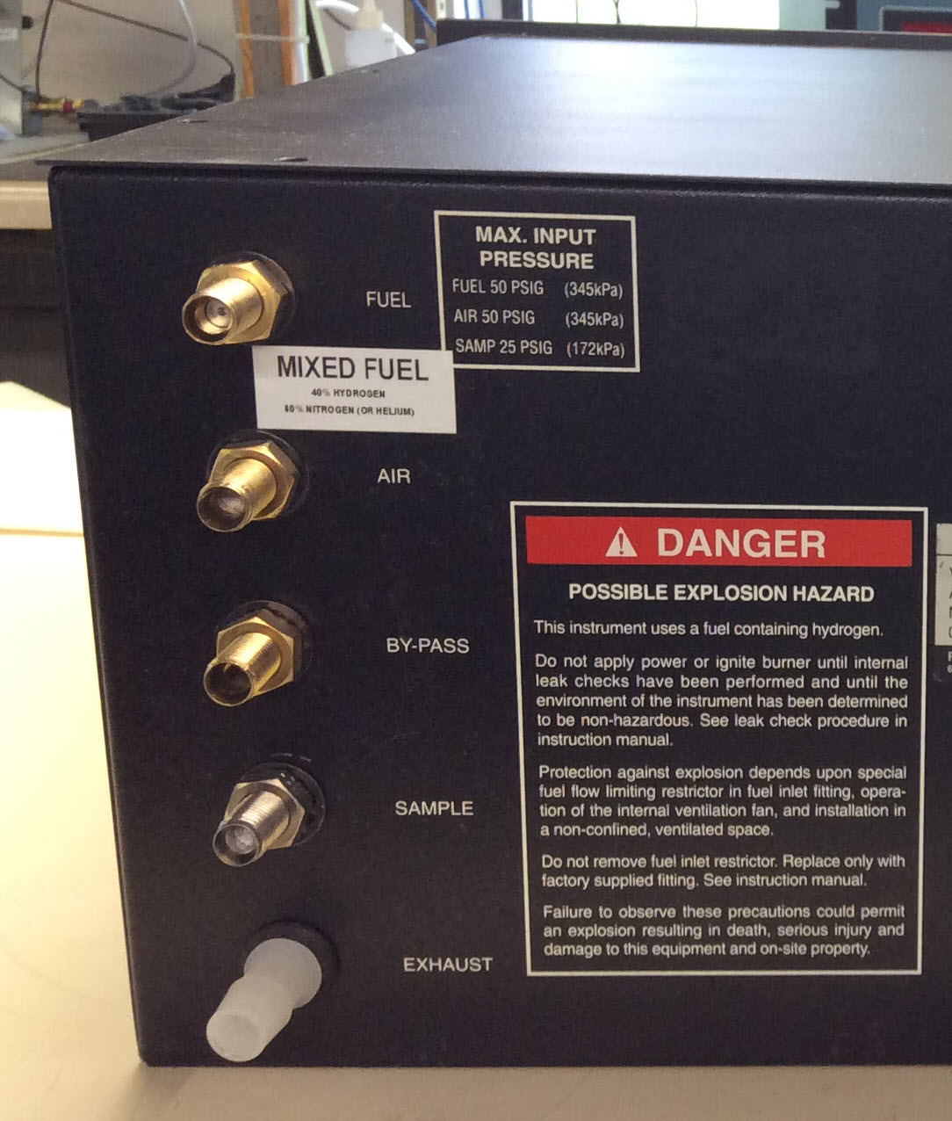
Gases & their connections
Fuel. ALWAYS a “red dot” restrictor.
Air. ALWAYS a frit (for filtration).
Bypass. ALWAYS without restriction.
Sample. ALWAYS with restriction.
Exhaust. ALWAYS open to atmos.

Slide 29
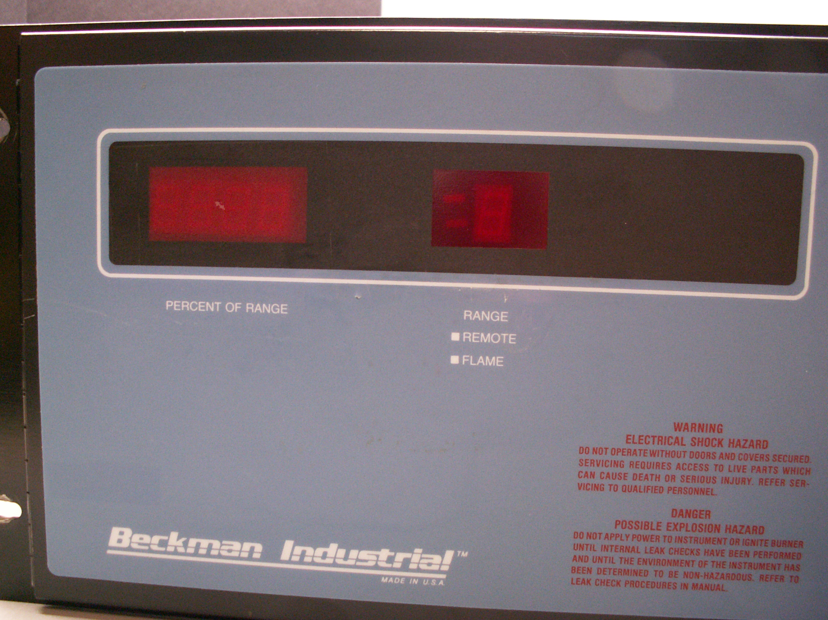
Displays
Range switch in REMOTE
-199.9% to +199.9 %
Range number
Flame status (lit when flame is detected)

Slide 30
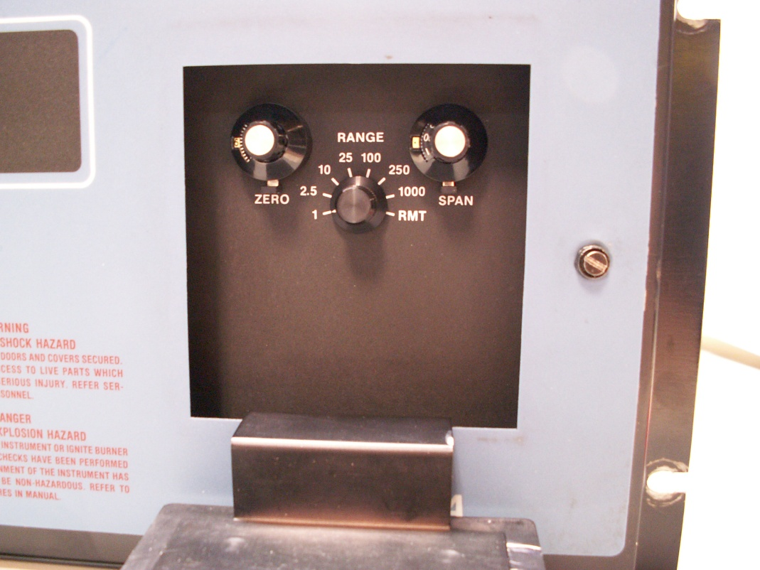
Controls
Zero adjustment
Span adjustment
Range (multiplier) selector switch

Slide 31
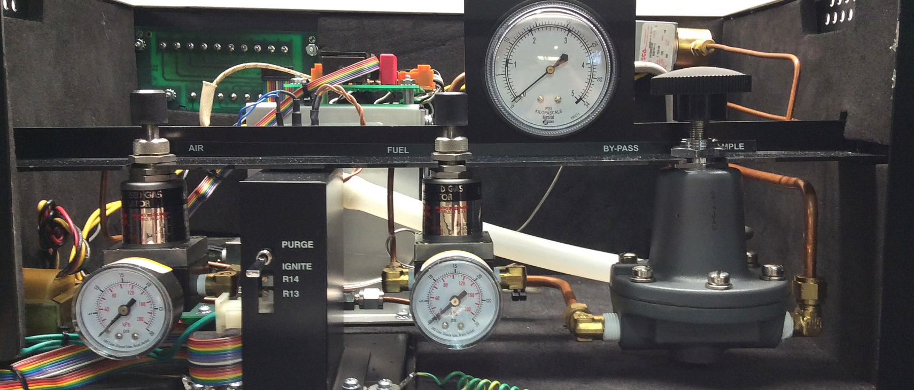
Controls
Burner air pressure
Fuel pressure
Sample pressure
Purge / Ignite
Backpressure regulator

Slide 32
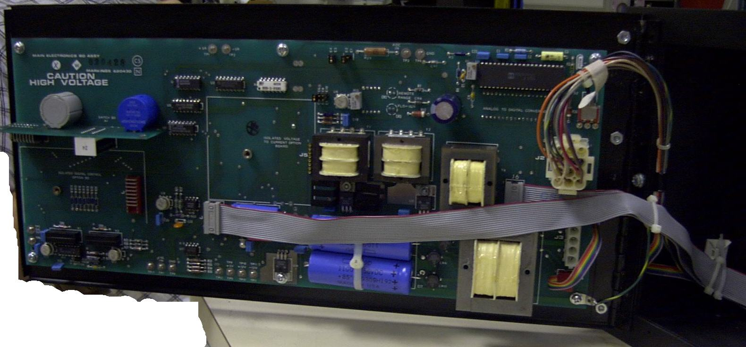
Main Electronics Board (pre 2009)
Display trim adjustment
On – Off switch
4-20 mADC Option Board
To Preamp Board
To Outputs
To Heater Control Board

Slide 33
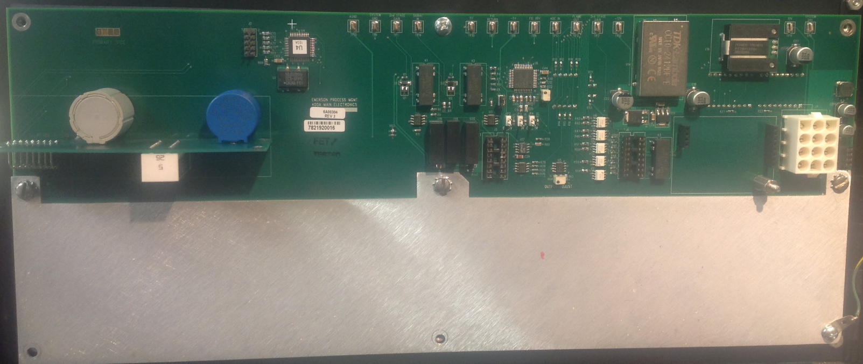
Main Electronics Board (2009 and later)
Display trim adjustment
4-20 mADC Option Board
To Outputs
To Heater Control Board
To Preamp Board

Slide 34
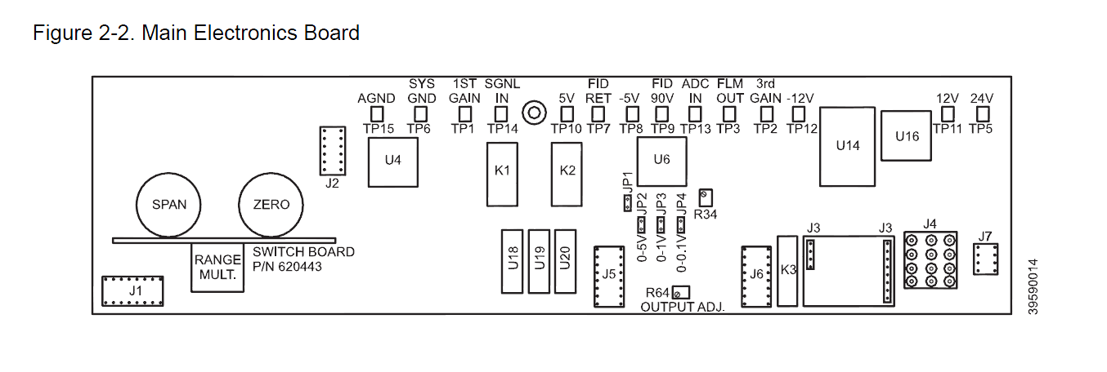
Main Electronics Board (2009 and later)
Display trim adjustment

Slide 35
Main Electronics Board (schematic)
See PDF

Slide 36
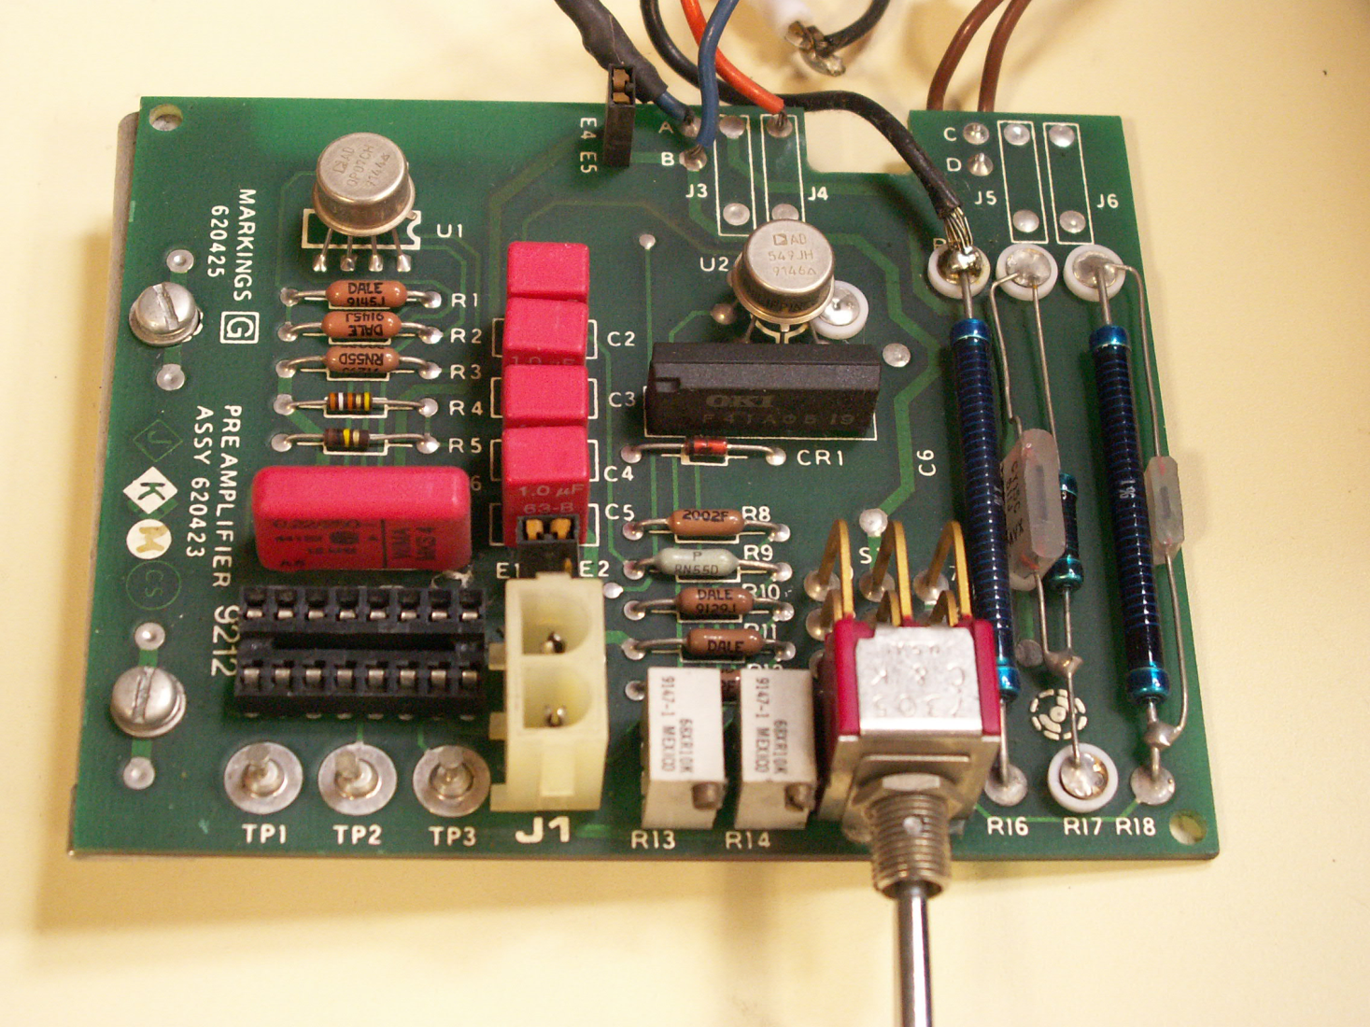
Preamplifier board
From Main Electronics Board
Trim & balance pots
Purge-Ignite switch

Slide 37
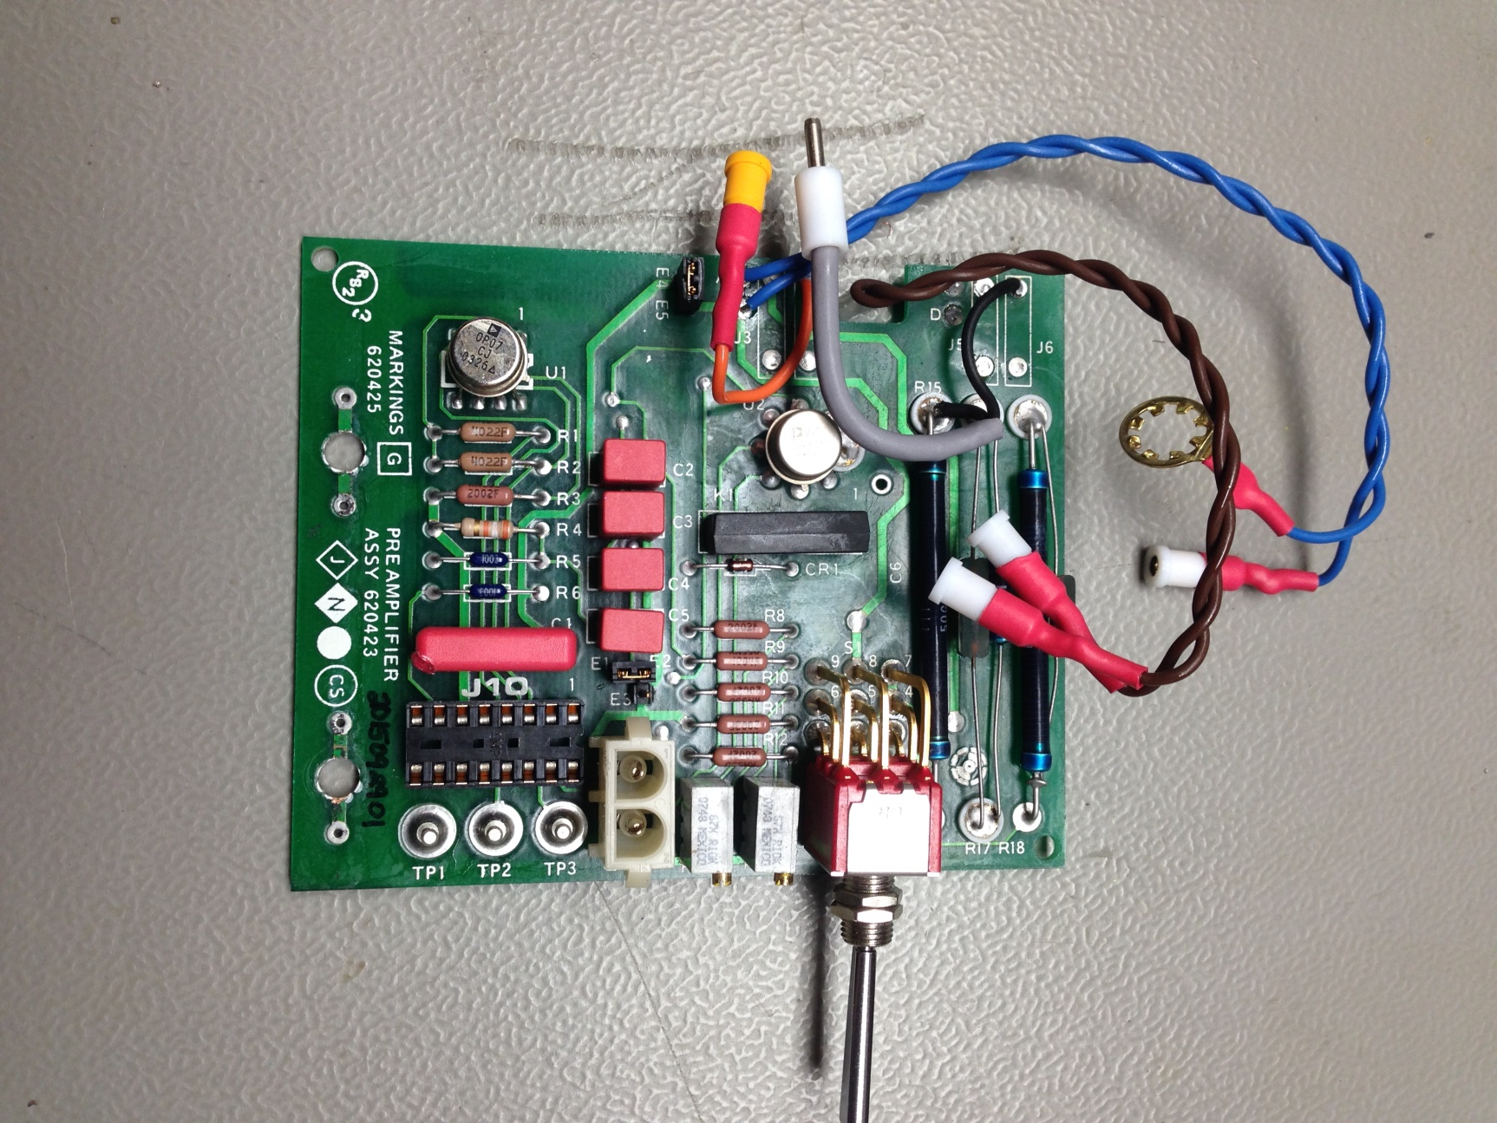
Preamplifier board (after repair)
Shielded cable
New wires
New sockets
Gold flashed DIP socket
Cleaned

Slide 38
Internals – top view (pre-2009)
Flame Safety Board (old version)
Heater assembly (old version)
Fuel solenoid valve
Burner
Purge-Ignite switch

Slide 39
Internals – burner
Burner cap
Thermistor
Exhaust port (not shown)
Glow plug
Burner cap ring
Chimney
Collector
Burner contact
Sample capillary connection
Burner jet
Burner manifold
Burner air restrictor
Fuel restrictor (other side, not visible)

Slide 40
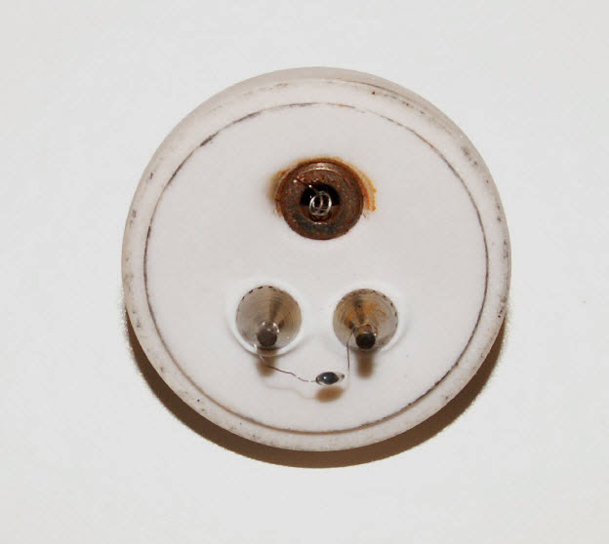
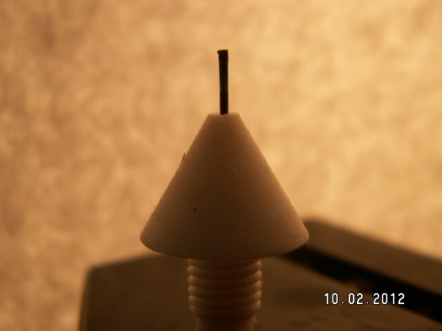
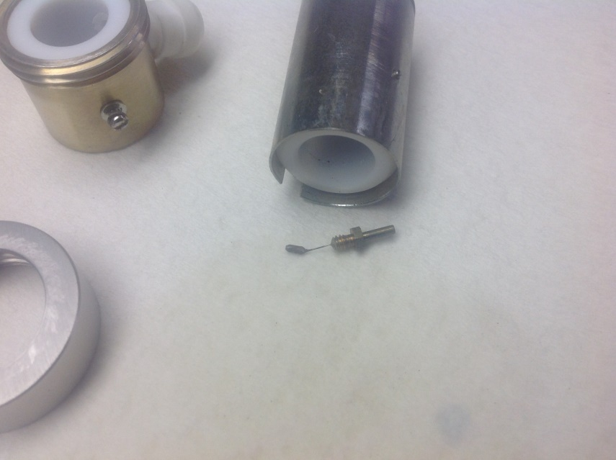
Internals – burner
Burner cap
Burner jet
Glow plug
Exhaust port
Thermistor
Collector
Chimney
Burner contact
(damaged)
Burner cap ring

Slide 41
Case heater
(later)

Slide 42
Flame Safety Board
(later)

Slide 43
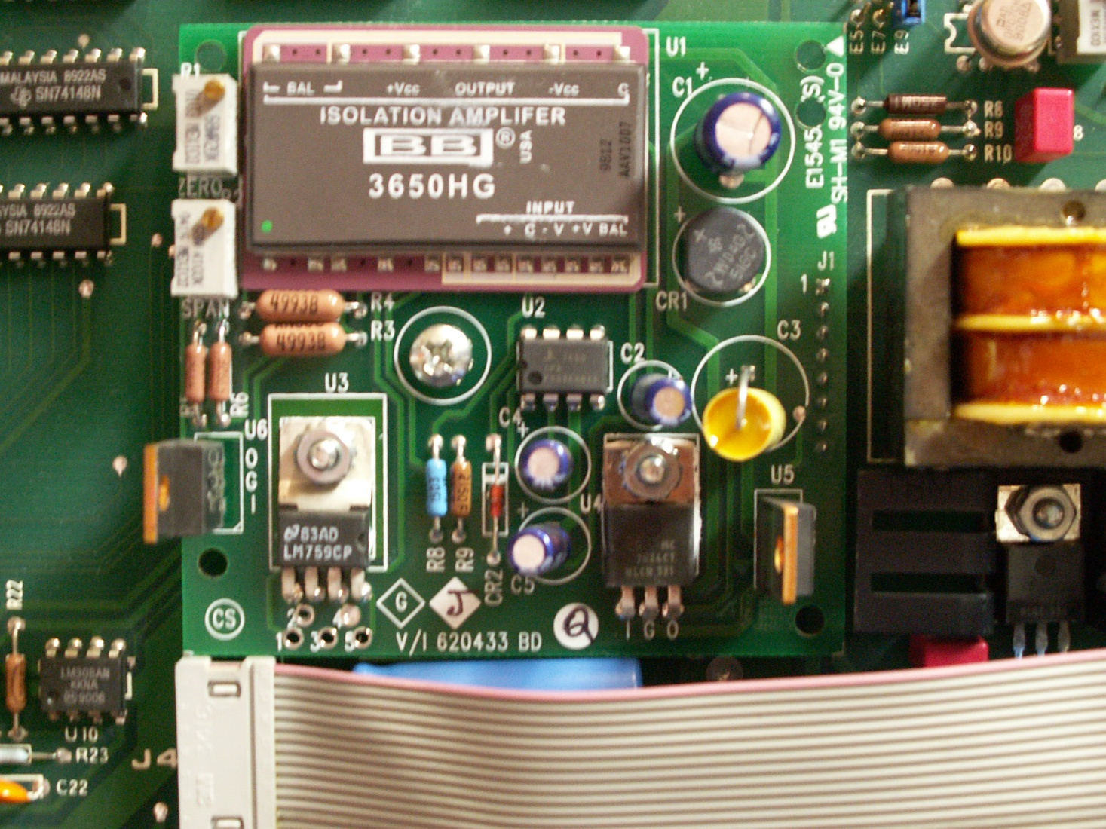
[opt] Isolated 4-20 mADC board (pre-2009)
Zero adjustment pot
Span adjustment pot

Slide 44
[opt] Isolated 4-20 mADC board (2009 and later)
Zero adjustment pot
Span adjustment pot

Slide 45
Startup procedure
Verify that fuel is available at the rear of the instrument @ 35 to 50 psig
Verify that burner air is available at the rear of the instrument @ 25 to 50 psig
Verify that sample is available at the rear of the instrument is @ __ psig (discussed earlier)
* anything that gets us about +10 psig above our control setting is fine
* anything that gets us about +10 psig above our control setting is fine

Slide 46
Startup procedure
Lighting (procedure available on line):
Turn air pressure down to near 0 psi
Select “purge” (not “ignite”)
Adjust fuel to 25 – 30 psi
Flood burner with fuel for 30 – 45 seconds
Add 5 psi of air rapidly
Continue to raise air at ½ psi per minute AND select “ignite”
Wait for the pop (H₂ explosion)
Release the “purge/ignite” switch
* A technical bulletin will be posted

Slide 47
Startup procedure
(Continued)
(you might have to select “purge” for a few extra seconds while the heat builds up)
“It won’t light” scenarios presented later
Using a volt meter to observe flame temperature can/will reveal what is actually occurring in the burner.
When voltage drops to less than (approx.) 1.0 vDC, the Flame Safety Board will latch the solenoid valve open.
Expect between 2.5 and 5.5 vDC at TP13 when unlit
Expect < 250 mVDC (0.25 vDC) when lit (100 mVDC seems ideal)
Readings < 75 mVDC indicate too much fuel / heat

Slide 48
Calibration
A typical calibration (mixed fuel)
Range 4 selected
Internal pressures:
Fuel @ 25, Air @ 15, Sample @ 3
Flow N₂ (apply pressure*) … wait … adjust zero pot
Flow 100 ppm gas … wait … adjust gain/span pot to achieve a reading of 100%
Or flow 80 ppm gas … wait … adjust pot to achieve 80%
For other calibration scenarios use the 400A Calculator (demonstrated later)

Slide 49
All is good … if:
Flame light is lit
Internal pressures are:
Fuel = 25psi*, Air = 15psi*, Sample = 5psi*
(* or as defined by your SOP or affixed placard from RIGAS)
Responds to zero, span, and process gases
Range switch is in its ‘usual’ position
Zero pot is >50% (the higher, the better)
Process changes are sensed quickly
Internal sample pressure does not change when going from cal gases to sample gas

Slide 50
But what is it supposed to read?
This is a “percent of range” instrument. That is, the readings are based on percent of the calibration parameters.
Example:
Calibrated range: 0-300 ppm (0-100% displayed)
Cal gas is 150 ppm
150 / 300 = 50% … therefore calibrate to achieve a reading of 50.0 on the display
Go to RIGAS’ 400A Calculator (an interactive Excel Spreadsheet) for a demonstration

Slide 51
“It won’t light”
Here are some possibilities:
Burner has an air leak
Glow plug is burned out
Not enough fuel flow
Not enough air flow
Burner jet is deformed
Thermistor is bad

Slide 52
“It won’t light”
Burner has an air leak
Glow plug is burned out
Not enough fuel flow
Not enough air flow
Burner jet is deformed
Thermistor is bad

Slide 53
“It won’t light” (air leak)
Pops
Thermistor doesn’t see enough heat
Measure TP13 to TP8 (gnd)
2 to 5 vDC means no flame
1.0 vDC is the minimum to lock in the flame safety
0.1 vDC is a good typical operating temperature
Chimney is not seated
Burner cap loose (& not oriented correctly)

Slide 54
“It won’t light” (air leak)
Burner cap loose or skewed
The ceramic disc (burner cap) has a lip that needs to set down in to the chimney, and then held down with the threaded collar. The collar just needs to be snug.
Chimney
Collector not seated fully
The collector has a tin can (shell or shroud) that needs to set down fairly flush with the manifold base. In order to achieve this, the tin can needs to be pried open. We use spring clip pliers to spread the can open just enough so that it can get over the lip of the manifold base. Once in place, cinch down the pipe clamp snug.

Slide 55
“It won’t light” (air leak)
Thermistor posts
Exhaust fitting
Glow plug
Heat rises and passes directly past the thermistor bead

Slide 56
“It won’t light”
Burner has an air leak
Glow plug is burned out
Not enough fuel flow
Not enough air flow
Burner jet is deformed
Thermistor is bad

Slide 57
“It won’t light” (glow plug issue)
Measure 3 vAC across the glow plug when in “ignite” position
Observe a glow up the exhaust fitting
there must be oxygen present in the chamber in order to actually see it glow; you may have to dim the lights nearby.
Observe TP13 & TP8 (gnd)… the voltage will dip if the glow plug is heating up
Normal problem(s):
Replace glow plug as necessary
Reattach the connector to the top of the glow plug
Unusual problems:
Resolder the wire to the ring terminal
Transformer is bad; replace it

Slide 58
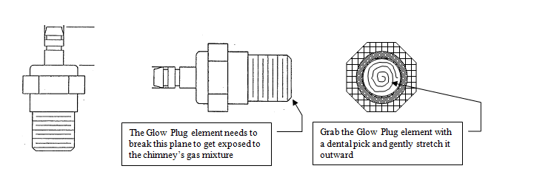
“It won’t light” (glow plug issue)
New glow plugs must be modified (‘usually’ performed at the factory)
* A technical bulletin will be posted

Slide 59
“It won’t light”
Burner has an air leak
Glow plug is burned out
Not enough fuel flow
Not enough air flow
Burner jet is deformed
Thermistor is bad

Slide 60
“It won’t light” (fuel flow issue)
Is the power switch ‘on’?
Does the fuel solenoid ‘clank’ when “purge” or “ignite” is selected?
Is there a fuel source? (see fuel pressure specs)
Does fuel pressure rise rapidly to about 15 psi then slowly ramps up to 25 psi?
Replace restrictor (test the suspect restrictor if you have the equipment to do it)
There is a low probability that the bulkhead restrictor is plugged
There is a low probability that the burner jet is deformed
Temporarily run the analyzer with a HIGHER fuel pressure … 30 psi or 35 psi (on the gauge peg)

Slide 61
“It won’t light”
Burner has an air leak
Glow plug is burned out
Not enough fuel flow
Not enough air flow
Burner jet is deformed
Thermistor is bad

Slide 62
“It won’t light” (air flow issue)
Is there an air source? (see air pressure specs)
Does air pressure follow the regulator setting?
Does the analyzer “pop” and then not maintain the flame?
Try raising the pressure to get more air (stop at 30 psi)
Replace restrictor (test the suspect restrictor if you have the equipment to do it)
There is a low probability that the bulkhead restrictor is plugged.
There is a low probability that the burner jet is deformed

Slide 63
“It won’t light”
Burner has an air leak
Glow plug is burned out
Not enough fuel flow
Not enough air flow
Burner jet is deformed
Thermistor is bad

Slide 64
“It won’t light” (burner jet deformed)
This one is a bit tough to track down
If it tries to light
but won’t maintain the flame AND
the jet is older than a few years then the jet is suspect
Remove the jet, inspect, pull the metal jet out of the Teflon skirt and reinsert it inverted
(this gets you a clean, pristine burner jet)

Slide 65
“It won’t light”
Burner has an air leak
Glow plug is burned out
Not enough fuel flow
Not enough air flow
Burner jet is deformed
Thermistor is bad

Slide 66
“It won’t light” (thermistor is bad)
This is an easy one …
Measure TP13 & TP8
Cold analyzer = 5 vDC (approx)
Lit analyzer = <1.0 vDC … usually around 0.2 vDC
Open thermistor circuit = 12 vDC (approx.)
Check the wires at the top of the burner
Check the wires coming off of the Preamp Board
Open the burner and inspect the very tiny filament wires going to the thermistor bead
Resistance values: cold = 100K ohms, lit = 1K

Slide 67
A factory calibration
Disconnect ribbon cable @ J4 first
Signal injection at TP7 to drive TP5 to 5.00 vDC
Adjust the display to read 100.0 counts
Adjust R13 to achieve the correct isolated voltage output (could be 0.1, 1.0, or 5.0 vDC depending on the jumper position)
Signal injection at TP7 to drive TP5 to 0.00 vDC
Adjust zero pot on 4-20 maDC board to 4.00 maDC
Signal injection at TP7 to drive TP5 to 5.00 vDC
Adjust span pot on 4-20 maDC board to 20.00 maDC
Repeat as necessary
Reconnect J4

Slide 68
Training aids available
Go to www.ri-gas.com

